Slide 1
CA LAB 9

Slide 2
Passive vs Active Sensors
Passive Sensors:
Detect electromagnetic radiation that is naturally reflected (visible, near-infrared, shortwave infrared) or emitted (thermal infrared) by objects.
Energy source = sun

Slide 3
Passive vs Active Sensors
Active Sensors:
Detect electromagnetic radiation that is backscattered from objects that are irradiated from artificially generated energy sources.
Energy sources = Radio, Sound, or Light Detection and Ranging systems

Slide 4
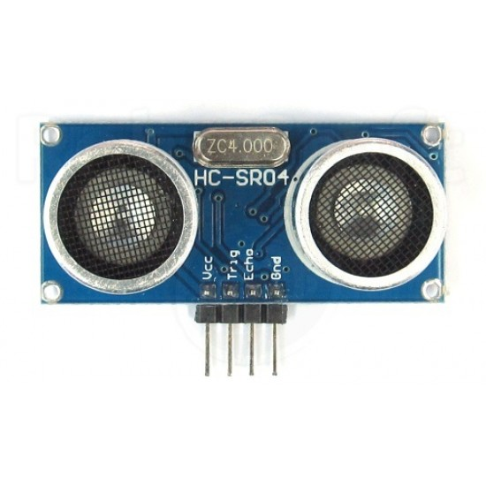
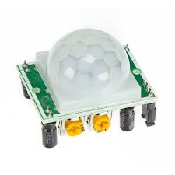
Ultrasonic Sensor
PIR Sensor

Slide 5
PIR (Passive Infrared Sensor)
It detects the infrared which is emitted by the objects(e.g: Humans, animals).
Used to detect motion in a specified area
Power is usually 3-5VDC input but may be as high as 12V.
They are also referred as Pyroelectric or IR motion sensors.

Slide 6
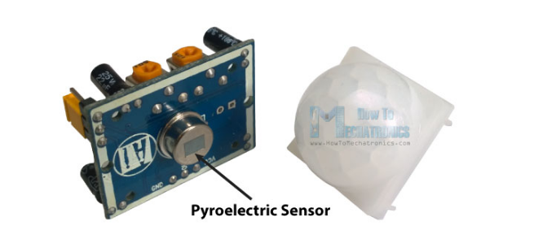

Slide 7
Working
It has a digital output.
PIR sensor detects any change in heat, and whenever it detects any change, its output PIN becomes HIGH.

Slide 8
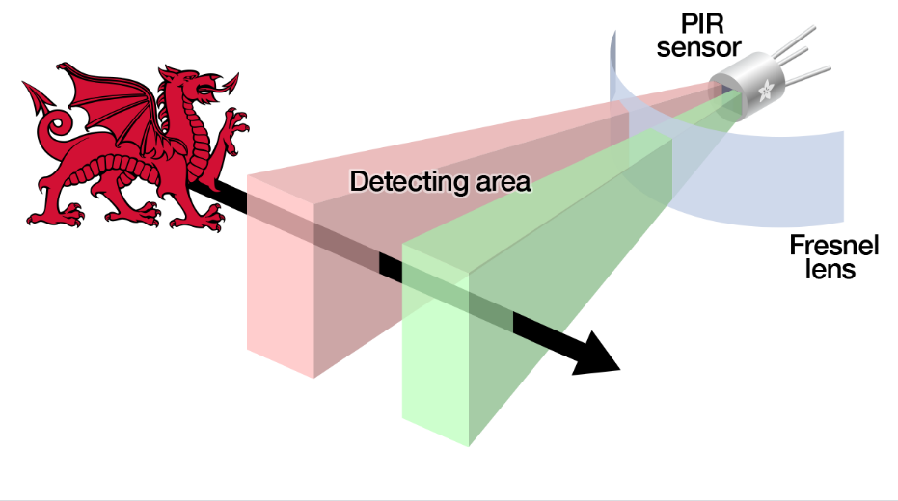

Slide 9
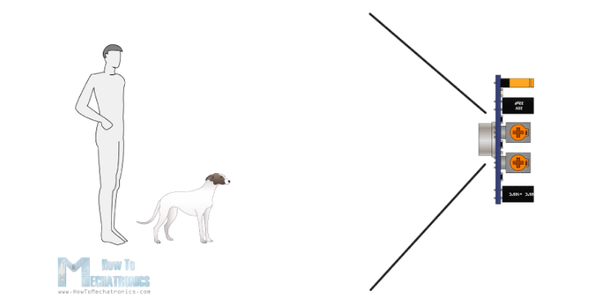

Slide 10
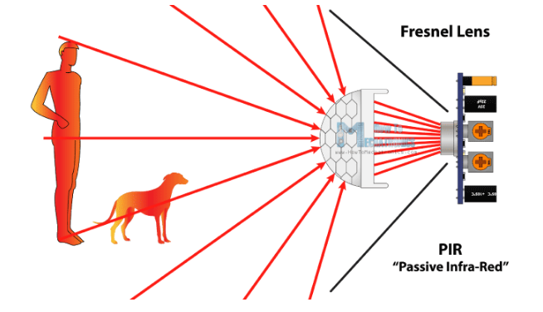

Slide 11
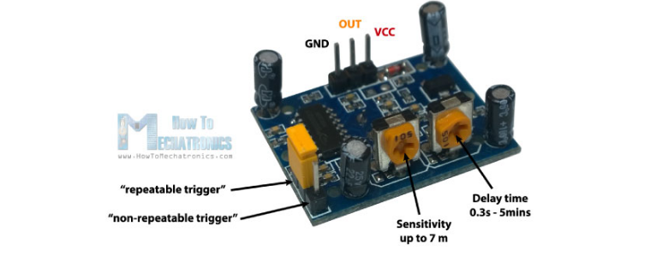

Slide 12
One POT is for adjusting the sensitivity of the sensor.
The other one is for adjusting the time the output signal stays high when object is detected.
This time can be adjusted from 0.3 seconds up to 5 minutes.

Slide 13
Trigger Modes
There are two trigger modes
non-repeatable trigger: when the sensor output is high and the delay time is over, the output will automatically change from high to low level.
repeatable trigger: will keep the output high all the time until the detected object is present in sensor’s range.

Slide 14
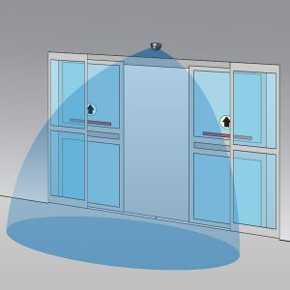
Example

